Slide 1
MOVIE RECOMMENDATION SYSTEM USING MACHINE LEARNING
Presented by :-
Ch.Sai ganesh-227r1a6681

Slide 2
ABSTRACT:
The aim of this project is to develop a movie recommendation system using a content-based filtering algorithm.
As the volume of available movies continues to grow, users often struggle to find films that match their personal tastes.
The algorithm analyzes features such as genre, director, cast, and plot summary to identify patterns and preferences.
By matching these features with the attributes of other movies, the system can recommend films that align with the user's preferences.

Slide 3
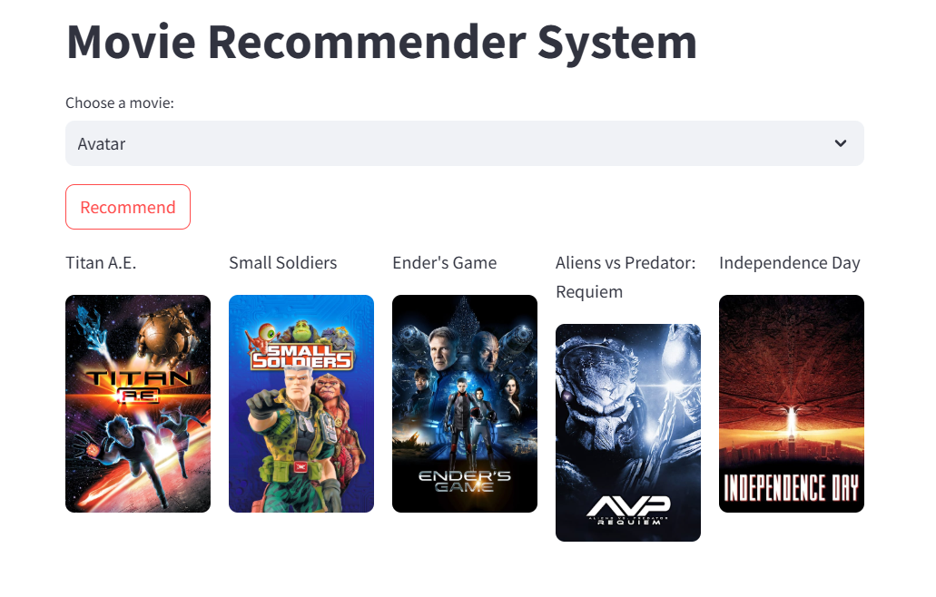
INTRODUCTION:
A movie recommendation system is a technology that suggests movies to users based on their past behavior, preferences, and similarities to other users.
It aims to provide personalized recommendations that are relevant and likely to be enjoyed by the user.

Slide 4
OBJECTIVES:
The primary objective is to accurately predict which movies a user is likely to enjoy.
This involves minimizing the difference between the system's recommendations and the user's actual preferences.
Accuracy is often measured using metrics like precision, recall.
The system should provide personalized recommendations tailored to individual user tastes. This means avoiding generic recommendations and instead focusing on movies that align with a user's past viewing history, ratings, and expressed preferences.

Slide 5
EXISTING SYSTEM:
A renowned platform like Netflix use a combination of collaborative filtering, content-based filtering, and other techniques to suggest movies and TV shows to their users.
Their system analyzes viewing history, ratings, and even the time of day to provide highly tailored recommendations.
Similar to Netflix, Amazon Prime Video also employs machine learning to power its recommendation engine.
They consider factors like viewing history, purchase history, and user demographics to suggest movies and TV shows that align with individual preferences.

Slide 6
DISADVANTAGES:
New users with little to no viewing history receive poor recommendations because the system has no data to work with. Similarly, new movies that haven't been rated by many users also suffer from this.
Users typically rate only a small fraction of available movies, leading to a sparse user-item matrix. This makes it difficult to find strong patterns and make accurate recommendations.
If the training data is biased (e.g., skewed towards certain genres or demographics), the recommendations will also be biased. This can lead to unfair or unrepresentative recommendations.

Slide 7
PROPOSED SYSTEM:
Existing movie recommendation systems utilize machine learning techniques such as collaborative filtering and content-based filtering.
Collaborative filtering predicts user preferences by analyzing the behavior of similar users or items, while content-based filtering suggests movies based on the attributes of the films themselves.
Many systems, like those used by Netflix and Amazon Prime, employ hybrid approaches to combine both methods, enhancing recommendation accuracy and user satisfaction.

Slide 8
ADVANTAGES:
The biggest advantage is receiving movie suggestions tailored to individual tastes. No more endless scrolling through irrelevant titles. The system learns your preferences and suggests movies you're likely to enjoy.
Beyond just recommending similar movies, these systems can expose users to hidden gems and films they might never have found on their own. This expands cinematic horizons and introduces users to new genres, actors, and directors.
Finding a good movie can be time-consuming. Recommendation systems drastically reduce the search time, allowing users to quickly find something they'll enjoy.

Slide 9
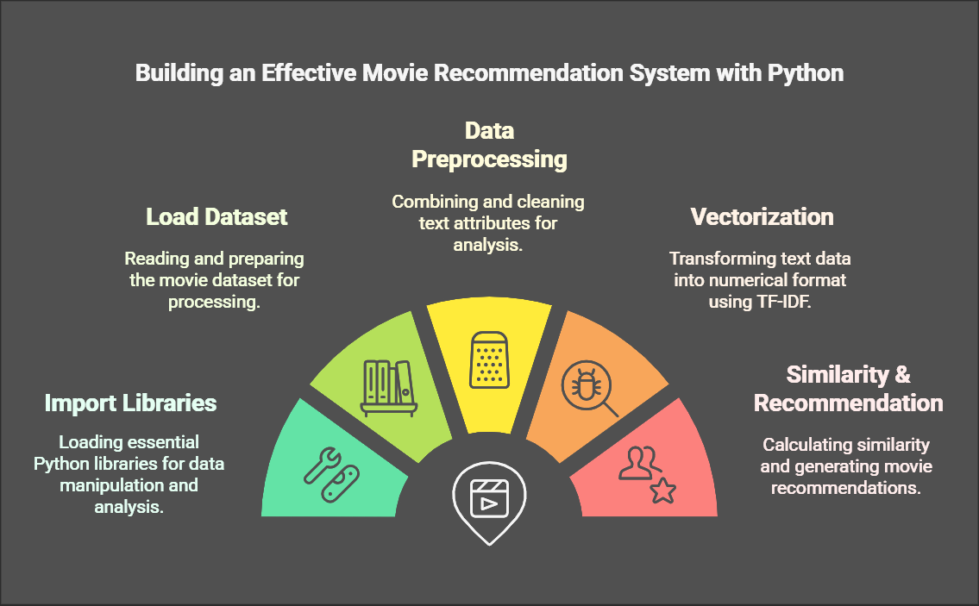
SYSTEM ARCHITECTURE:

Slide 10



Software & Hardware Requirements
Hardware Requirements

Slide 11
CONCLUSION:
In conclusion, a movie recommendation system using machine learning significantly enhances the user experience by providing personalized and relevant movie suggestions.
By leveraging advanced algorithms, such as collaborative filtering and content-based filtering, these systems can analyze vast amounts of data to predict user preferences accurately.
Challenges: such as data privacy, algorithmic bias, and the risk of overfitting exist, continuous improvements and ethical considerations can help mitigate these issues.

Slide 12


